Slide 1
IN THE NAME OF ALLAH THE MOST BENEFICENT AND MOST MERCIFUL

Slide 2
Thermal pollution
Thermal pollution is defined as the addition of excess of undesirable heat to water thereby making it harmful to man, animal or aquatic life. Thermal pollution may also cause significant departures from life activities of aquatic communities.
Sources of Thermal Pollution:
The following sources contribute to thermal pollution.
Nuclear power plants
Coal fired plants
Industrial effluents
Domestic sewage
Hydro-electric power

Slide 3
Nuclear power plants:
Nuclear power plants including drainage from hospitals, research institutions, nuclear experiments and explosions, discharge a lot of heat that is not utilized along with traces of toxic radio nuclides into nearby water streams.
Emissions from nuclear reactors and processing installations are also responsible for increasing the temperatures of water bodies.
The operations of power reactors and nuclear fuel processing units constitutes the major contributor of heat in the aquatic environment.
Heated effluents from power plants are discharged at 10 C higher than the receiving waters that affects the aquatic flora and fauna.

Slide 4
Coal-fired power plants:
Coal fired power plants constitute a major source of thermal pollution. The condenser coils in such plants are cooled with water from nearby lakes or rivers.
The resulting heated water is discharged into streams thereby raising the water temperature by 15C.
Heated effluent decreases the dissolved content of water resulting in death of fish and other aquatic organisms.
The sudden fluctuation of temperature also leads to "thermal shock" killing aquatic life that have become acclimatized to living in a steady temperature.
Industrial effluents:
Industries like textile, paper, pulp and sugar manufacturing release huge amounts of cooling water along with effluents into nearby natural water bodies.
The waters polluted by sudden and heavy organic loads result in severe drop in levels of dissolved oxygen leading to death of several aquatic organisms.

Slide 5
Domestic Sewage:
Domestic sewage is discharged into rivers, lakes, canals or streams with minimal treatment or without any treatment.
These wastes have a higher organic temperature and organic load. This leads to decrease in dissolved oxygen content in the receiving waters resulting in the set-up of anaerobic conditions causing release of foul and offensive gases in water.
Eventually, this leads to development of anoxic conditions resulting in rapid death of aquatic organisms.
Hydro-electric power:
Generation of hydroelectric power sometimes leads to negative thermal loading in water systems.
Apart from electric power industries, various factories with cooling requirement contribute to thermal loading.

Slide 6
Effects of Thermal pollution
Reduction in dissolved oxygen:
Dissolved Oxygen (DO) decreases with increase in temperature.
Increase in toxicity: The rising temperature increases the toxicity of the poison present in water.
A 10ºC increase in temperature of water doubles the toxicity effect of potassium cyanide.
while 80ºC rise in temperature triples the toxic effects of o-xylene causing massive mortality to fish.
Interference in biological activity:
Temperature is considered to be of vital significance to physiology, metabolism and biochemical processes that control respiratory rates, digestion, excretion, and overall development of aquatic organisms.
Temperature changes cause total disruption to the entire ecosystem.

Slide 7
Interference in reproduction:
In fishes, several activities like nest building, spawning, hatching, migration and reproduction depend on optimum temperature.
Direct mortality:
Thermal pollution is directly responsible for mortality of aquatic organisms.
Increase in temperature of water leads to exhaustion of microorganisms thereby shortening the life span of fish.
Above a certain temperature, fish die due to failure of respiratory system and nervous system failure.
Food storage for fish:
Abrupt changes in temperature alters the seasonal variation in the type and abundance of lower organisms leading to shortage of right food for fish at the right time.

Slide 8
Control measures for thermal pollution
The following methods can be adapted to control high temperature caused by thermal discharges:
Cooling towers: Cooling towers transfer heat from hot water to the atmosphere by evaporation. Cooling towers are of two types:
(i) Wet cooling tower:
Hot water coming out from the condenser (reactor) is allowed to spray over baffles.
Cool air, with high velocity, is passed from sides, which takes away the heat and cools the water.
(ii) Dry cooling tower:
Here, hot water is allowed to flow in long spiral pipes. Cool air with the help of a fan is passed over these hot pipes, which cools down hot water. This cool water can be recycled.

Slide 9
Cooling ponds:
Cooling ponds are the best way to cool thermal discharges. Heated effluents on the surface of the water in cooling ponds maximize dissipation of heat to the atmosphere and minimize the water area and volume.
Spray ponds:
The water coming out from condensers is allowed to pass into the ponds through sprayers.
Here water is sprayed through nozzles as fine droplets. Heat from the fine droplets gets dissipated to the atmosphere.
Artificial lakes:
Artificial lakes are man-made water bodies that offer once-through cooling.
The heated effluents can be discharged into the lake at one end and water for cooling purposes may be withdrawn from the other end. The heat is eventually dissipated through evaporation.

Slide 10
Green House Effect & Global Warming
There is a protective layer of ozone between 15 km to 60 km above the surface of the earth.
The thickest layer of ozone is present at a distance of 23 km above the surface of the earth.
While, a layer of CO₂ is present at 15 km above the surface of the earth.
When the sunlight containing visible, infrared and ultraviolet radiations fall on the ozone layer.
The ultraviolet radiations are absorbed by the ozone layer while, the infrared radiations of shorter wavelength and visible radiations pass from the ozone layer as well as layer of CO₂.
These radiations reach the earth and warm its objects.

Slide 11
When the earth and its objects are heated they start emitting the infrared radiations of longer wavelength (while, the radiations which come from the sunlight are of shorter wavelength infrared radiations)
These radiations of longer wavelength are trapped by the layer of CO₂ and this layer of CO₂ does not allow these radiations to go out from the atmosphere.
Thus therefore, these radiations increase the temperature of the atmosphere.

Slide 12
So, the greenhouse effect can be defined as:
“The heating of the earth due to trapping of the infrared radiations of longer wavelength by the CO₂ layer present in the atmosphere is called as greenhouse effect”.

Slide 13
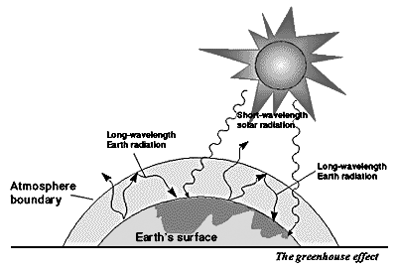

Slide 14
Other Green House Gases
There are some other gases which also cause greenhouse effect. These gases are:
(a) Methane (CH₄) 18%
(b) Surface Ozone (O₃) 12%
(c) CFC’s and other refrigerating agents (14%)
(d) Nitrous Oxide (6%)

Slide 15
Industrial operations are a big source of change in the atmosphere.
Industrial gases usually contain sulphur dioxide, hydrogen sulphide and Nitrous oxide.
While methane is added due to the agricultural practices. Rice fields yield 115 million ton methane every year.
Methane comprises about 2 ppm of the atmosphere but it is 30 times more active the CO₂ regarding warming action.

Slide 16
Means of transport e.g., cars, buses, scooters, etc. add gases like CO, CO₂, NO, lead SO₂ etc. They also add lead and benzene all these species add to global warming.
“Thus global warming is phenomena by which the temperature of this earth is increasing day by day due to increase in the greenhouse effect”.

Slide 17
Importance of Green House Effect
The greenhouse effect produced by the presence of CO₂ layer in the atmosphere is very important of our existence on the earth.
Due to greenhouse effect the temperature of the earth rises.
Without greenhouse effect the temperature of the earth would not increase and it would be converted into a cold planet. Where life could not be possible.

Slide 18
Increase in Carbon Dioxide and Its Impact
The amount of carbon dioxide has increased to greater extent in the previous two and a half centuries.
After industrial revolution (1750), the amount of CO₂ was 265 ppm in 1850 and it was 340 ppm in 1987.
While it is estimated that this amount will increase to 600 ppm upto 2050.

Slide 19
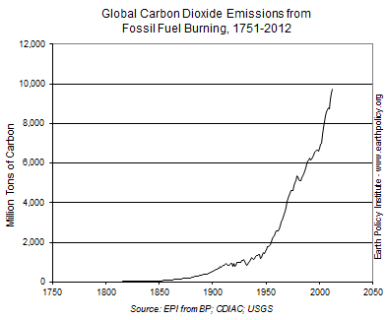

Slide 20
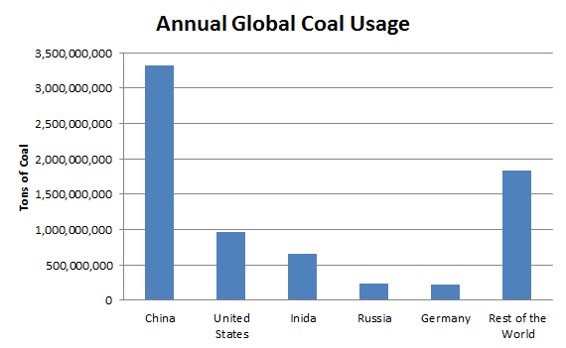

Slide 21
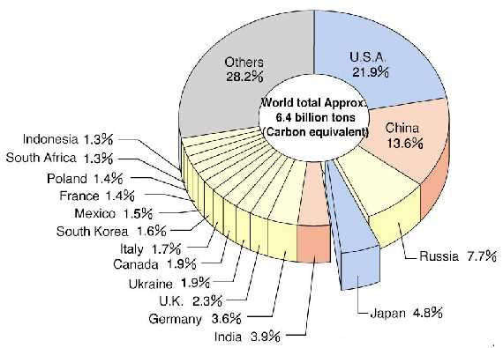

Slide 22
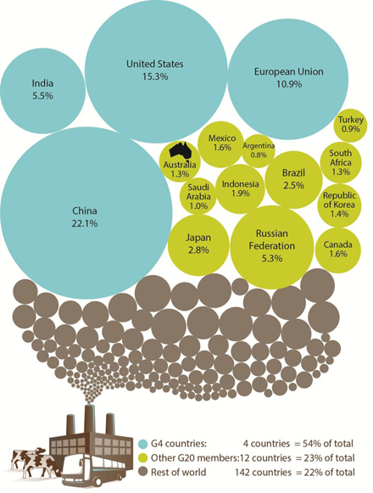
Major Emitters of the World

Slide 23
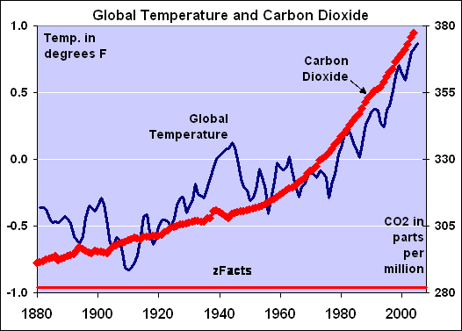

Slide 24
Effects of Global Warming
Global warming may make some regions more hospitable, for longer periods.
it probably will result in longer, more intense heat waves in the warmer spots of the world.
It also may trigger natural disasters, including floods, hurricanes and drought.
Increased precipitation and temperatures in certain areas could encourage the breeding of disease carrying pests, such as mosquitoes.
Greater heat also may increase the production of ground-level ozone, a pollutant which can damage your lungs.

Slide 25
Disadvantages of Global Warming
Ocean circulation disrupted, disrupting and having unknown effects on world climate.
Higher sea level leading to flooding of low-lying lands and deaths and disease from flood and evacuation.
Deserts get drier leaving to increased desertification.
Changes to agricultural production that can lead to food shortages.
Water shortages in already water-scarce areas.
Starvation, malnutrition, and increased deaths due to food and crop shortages.
More extreme weather and an increased frequency of severe and catastrophic storms.
Increased disease in humans and animals.
Increased deaths from heat waves.
Extinction of additional species of animals and plants.

Slide 26
Loss of animal and plant habitats.
Increased emigration of those from poorer or low-lying countries to wealthier or higher countries seeking better conditions.
Additional use of energy resources for cooling needs.
Increased air pollution.
Permanent loss of glaciers and ice sheets.
Cultural or heritage sites destroyed faster due to increased extremes.
Increased acidity of rainfall.
Earlier drying of forests leading to increased forest fires in size and intensity.
Aggressiveness will increase leading to an increase in the murder rate.

Slide 27
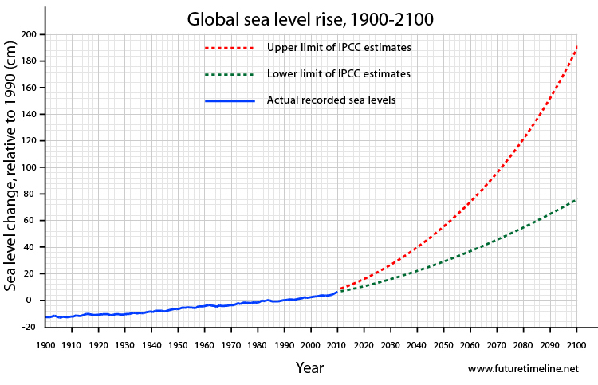

Slide 28
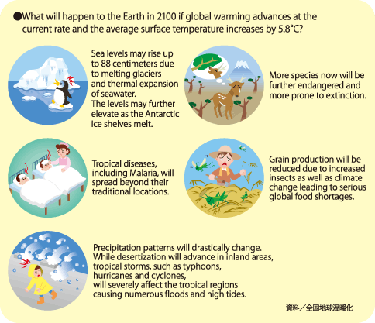

Slide 29
How to Prevent Global Warming
We may be able to decrease our carbon footprint and stop or slow global warming.
For example, replacing the incandescent light bulbs in your home with compact fluorescent bulbs can lower your electric bill and reduce carbon dioxide emissions.
Walking to your destination instead of taking the car is another way to reduce global warming.
Recycling and using recycled products.
installing alternative energy sources such as solar panelling and buying energy-efficient device also can contribute mightily.

Slide 30
Sunny Sides of Global Warming
Climatic change is expected to have disastrous effects for Earth but some areas like northern parts of Europe, Russia and the US will get benefit.
Melting of snow and ice will flourish agriculture, shipping, oil, gas and mining sectors of rich countries of the north.
 Agriculture in the polar region is expected to expand too, because farming season increases by increasing temperature.
 Fishing in the northern sea would expand. The herring, the Tuna and the Brisling are slowly going north (northern part of Atlantic oceans).
 The forestry industry can grow also because a warmer temperature means trees can grow at higher latitudes.

Slide 31

Summer tourism could increase in northern European countries, as Italy Spain and Greece become too hot in July and August.
Commercial shipping would also expand as the ice sheet shrinks, with navigation days in the Arctic Ocean increasing from 30 days today to between 120 and 140 days by 2099.
Exploration of natural resources in Siberian region will increase due to melting of ice. A Russian company Gazprom has started the exploration of gas and oil resources.

Slide 32
International efforts to control climatic change
In the 19th century, an awareness began to dawn that accumulated carbon dioxide in the Earth’s atmosphere could create a “greenhouse effect” and increase the temperature of the planet.
A perceptible process in that direction had already begun — a side-effect of the industrial age and its production of carbon dioxide and other such "greenhouse gases.“
By the middle of the 20th century, it was becoming clear that human action had significantly increased the production of these gases, and the process of “global warming” was accelerating.
Today, nearly all scientists agree that we must stop and reverse this process now — or face a devastating cascade of natural disasters that will change life on earth as we know it.
Much of the evidence already seems apparent to the layman as well. Most of the hottest years on record have occurred during the past two decades.
In Europe, the heat wave in the summer of 2003 resulted in over 30,000 deaths. In India, temperatures reached 48.1 degrees Centigrade — nearly 119 degrees Fahrenheit.

Slide 33
In 1992, its “Earth Summit” produced the United Nations Framework Convention on Climate Change (UNFCCC) as a first step in tackling the problem.
In 1998, the World Meteorological Organization (WMO) and the United Nations Environment Programme (UNEP) set up the Inter governmental Panel on Climate Change (IPCC) to provide an objective source of scientific information.
And the Convention’s 1997 Kyoto Protocol, which set emission reduction targets for industrialized countries, has already helped stabilize and in some cases reduce emissions in several countries.
The UN has consistently taken the lead in taking on climate change. In 2007, the Nobel Peace Prize was awarded jointly to former United States Vice-President Al Gore and the IPCC "for their efforts to build up and disseminate greater knowledge about man-made climate change, and to lay the foundations for the measures that are needed to counteract such change".

Slide 34
The Kyoto Protocol set standards for certain industrialized countries. Those targets expired in 2012.
In the meanwhile, greenhouse gas emissions from both developed and developing countries have been increasing rapidly.
The Copenhagen Accord was agreed to by Heads of State, Heads of Government, Ministers and other heads of delegation at the UN Climate Change Conference in Copenhagen in December 2009.
In December 2010, climate change talks in Cancún concluded with a package of decisions to help countries advance towards a low-emissions future.
In 2011 the world population reached 7 billion. It is expected to grow to 9 billion by 2043, placing high demands on the Earth’s resources.

Slide 35
In 2011 the UN Climate Change Conference in Durban, South Africa produced the Durban Platform .
In Durban, governments decided to adopt a universal legal agreement on climate change as soon as possible, but not later than 2015.
In December 2012, after two weeks of negotiations at Doha conference, nations moved forward on climate change and extended the Kyoto Protocol.
The renewal will keep existing climate targets until a new international agreement comes into effect in 2020, pending a new pact to

Slide 36
Kyoto Protocol
The Kyoto Protocol is an international agreement linked to the United Nations Framework Convention on Climate Change, which commits its Parties by setting internationally binding emission reduction targets.
Recognizing that developed countries are principally responsible for the current high levels of GHG emissions in the atmosphere as a result of more than 150 years of industrial activity
The Protocol places a heavier burden on developed nations under the principle of "common but differentiated responsibilities.“
The Kyoto Protocol was adopted in Kyoto, Japan, on 11 December 1997 and entered into force on 16 February 2005. Its first commitment period started in 2008 and ended in 2012.

Slide 37
Doha Amendments
In Doha, Qatar, on 8 December 2012, the "Doha Amendment to the Kyoto Protocol" was adopted. The amendment includes:
New commitments for Annex I Parties to the Kyoto Protocol who agreed to take on commitments in a second commitment period from 1 January 2013 to 31 December 2020.
A revised list of greenhouse gases (GHG) to be reported on by Parties in the second commitment period; and
Amendments to several articles of the Kyoto Protocol which specifically referenced issues pertaining to the first commitment period and which needed to be updated for the second commitment period.
During the first commitment period, 37 industrialized countries and the European Community committed to reduce GHG emissions to an average of five percent against 1990 levels.
During the second commitment period, Parties committed to reduce GHG emissions by at least 18 percent below 1990 levels in the eight-year period from 2013 to 2020; however, the composition of Parties in the second commitment period is different from the first.

Slide 38
The road ahead
The Kyoto Protocol is seen as an important first step towards a truly global emission reduction regime that will stabilize GHG emissions, and can provide the architecture for the future international agreement on climate change.
In Durban, the Ad Hoc Working Group on the Durban Platform for Enhanced Action (ADP) was established to develop a protocol, another legal instrument or an agreed outcome with legal force under the Convention, applicable to all Parties.
The ADP is to complete its work as early as possible, but no later than 2015, in order to adopt this protocol, legal instrument or agreed outcome with legal force at the twenty-first session of the Conference of the Parties and for it to come into effect and be implemented from 2020.

